Slide 1
Ensembl Variation API – Part 1
Anja Thormann
Andrew Parton
April 24th 2018 Hinxton

Slide 2
Important URLs
Course material
https://github.com/Ensembl/ensembl-presentation/tree/master/API/Variation/Hinxton1804
Ensembl Variation API documentation
http://www.ensembl.org/info/docs/Doxygen/variation-api/index.html
Ensembl Core API documentation
http://www.ensembl.org/info/docs/Doxygen/core-api/index.html
Variation data documentation
http://www.ensembl.org/info/genome/variation/index.html

Slide 3
Genomic variation
image credit: humanae.tumblr.com
https://www.yourgenome.org/facts/what-is-genetic-variation
Notes:
Differences that make us unique and determine our phenotypes,
Eye colour, skin tone and face shape are all determined by our genes so any variation that occurs will be due to the genes inherited from our parents
Genetic variation can also explain some differences in disease susceptibility and how people react to drugs

Slide 4
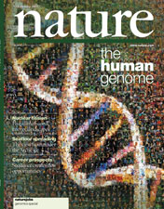

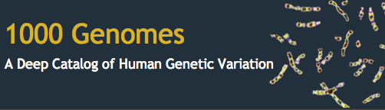
Sequencing Revolution
2000
2010
2015
ExAC
gnomAD
Notes:
TOPMed
UK10K
Biobank

Slide 5
International HapMap consortium
1.6 million common single nucleotide polymorphisms (SNPs) from 1,184 individuals from 11 global populations
Linkage disequilibrium – nonrandom association of alleles at different loci
Sets of nearby SNPs on the same chromosome are inherited in blocks
genome-wide association study GWAS: examination of a genome-wide set of genetic variants in different individuals to see if any variant is associated with a trait

Slide 6
1000 Genomes Project
Properties and distribution of common and rare variation
Advances in sequence data generation, archiving and analysis
2,504 individuals from 26 populations
Low-coverage whole-genome sequencing
Deep exome sequencing
Dense microarray genotyping
88 million variants

Slide 7
2,504 individuals from 26 populations

Slide 8
A typical genome
Differs from the reference human genome at 4.1 million to 5.0 million sites
>99.9% of variants consist of SNPs and short indels
Reference allele: A
Alternative allele: G
Contains 2,100 to 2,500 structural variants
Reference genome
C | G | C | A | G | - | T | G | A
C | G | C | G | G | C | T | G | -
A typical genome
SNP
insertion
deletion

Slide 9
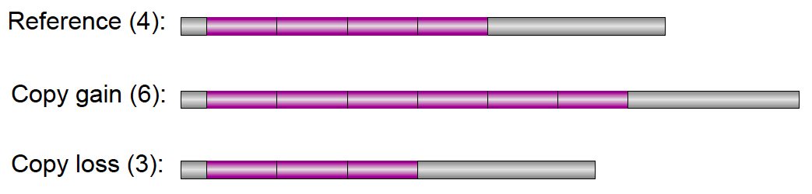
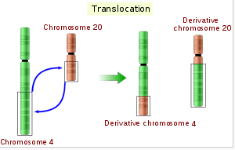
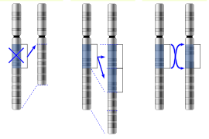
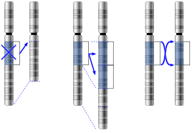
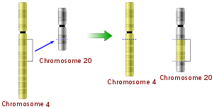
Structural variation
Copy number variations (CNVs): sequence repeated ‘n’ times in an individual
Large structural variants:
Large structural variants:
deletion
duplication
inversion
insertion
translocation

Slide 10
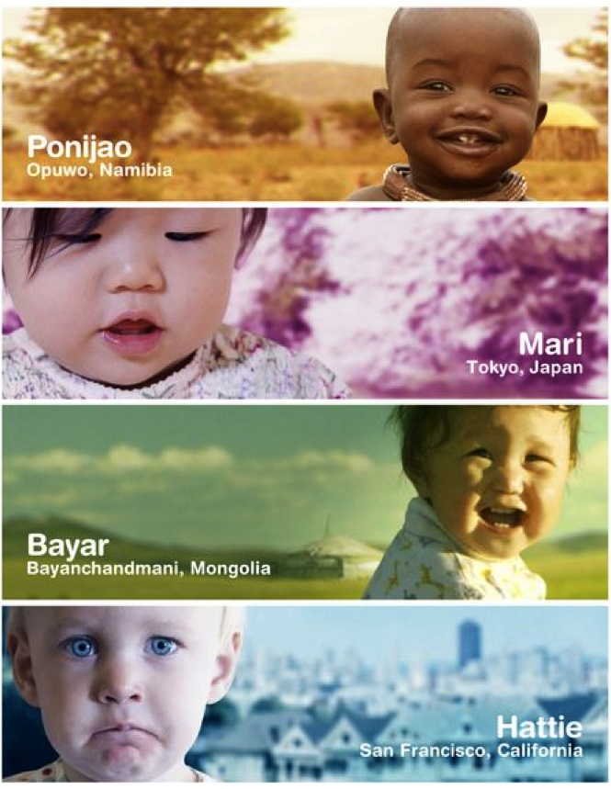
Diploid: 2 versions of each autosomal chromosome
A
Mother
G
Father
Genotype A|G

Slide 11
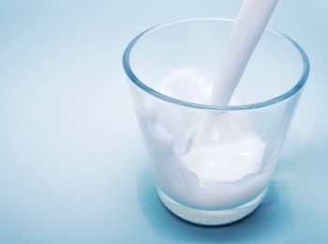
Lactose intolerance
rs4988235: a SNP near the LCT gene controls whether lactase enzyme is turned on or off as a person grows older
Alleles: G/A
ALL
AFRICAN
AMERICAN
EAST ASIAN
EUROPEAN
SOUTH ASIAN
Genotype | What does it mean
G/G | Likely to be lactose intolerant.
G/A | Likely to be tolerant due to lactase persistence.
A/A | Lactose tolerant
Notes:
rs4988235: a SNP near the LCT gene controls whether lactase enzyme is turned on or off as a person grows older.
Alleles: G/A

Slide 12





Allele Frequency in a population
Chromosome 7: 5678987-5678987
Reference Allele: G
G/G
A/A
A/G
G/G
Count alleles: 3 A, 5 G
Frequency for A: 3/8 = 0.375
Frequency for G: 5/8 = 0.625
A
0.375
0.625
G

Slide 13
Genotype to Phenotype

Slide 14
Genome-Wide Association Studies (GWAS)

Slide 15

Variation consequence
REF: CGCGGCGCTCGGTTGCCGGGCGAGGGAGGGCCGGCCCCCGCCGCGGAACCCCCGC
C→A
Regulatory region
TF binding site
Splice donor
Splice region
3’ UTR
Splice acceptor
Intron
Synonymous
Downstream
5’ UTR
Missense
Inframe insertion
Stop lost
Inframe deletion
Stop retained
Stop gained
Incomplete terminal codon
Frameshift

Slide 16
23 species with a variation database
http://www.ensembl.org/info/genome/variation/data_description.html#sources

Slide 17
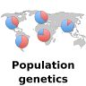

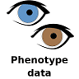





Import variants
Quality control
Import richer data
Apply analysis
Variation database
Notes:
The Ensembl Variation process

Slide 18
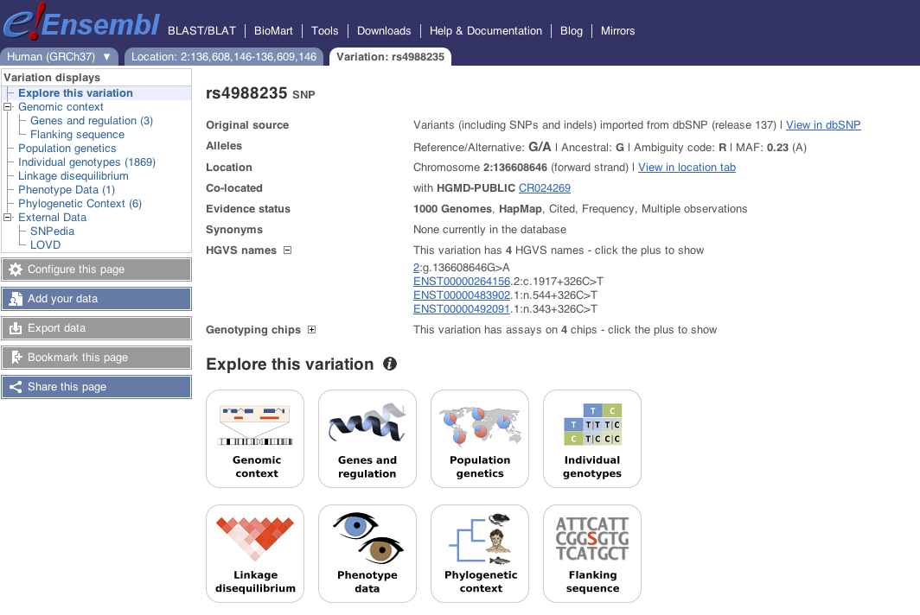
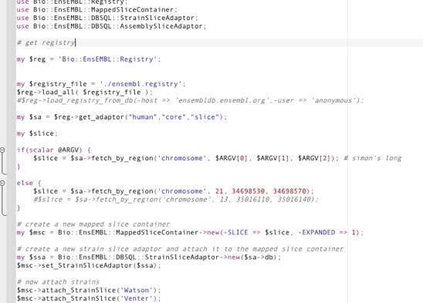


Variation database
Website
Scripts
API
REST
web service
Tools

Slide 19
http://www.ensembl.org/Homo_sapiens/Variation/Explore?v=rs4988235

Slide 20
Adaptors
Adaptors are factories for generating object
Adaptors are retrieved from the Registry
use Bio::EnsEMBL::Registry;
my $registry = ‘Bio::EnsEMBL::Registry’;
$registry->load_registry_from_db(
-host => ‘ensembldb.ensembl.org’,
-user => ‘anonymous’
);
my $va = $reg->get_adaptor(‘human’, ‘variation’, ‘variation’);
my $variation = $va->fetch_by_name(‘rs334’);
species
group
object name

Slide 21
Data retrieval
Adaptors
Fetch object(s) according to some property e.g. name, location
$adaptor->fetch_all_... returns a list reference of items
$adaptor->fetch_by_... returns only 1 item
Check documentation which methods the adaptor provides
API objects: e.g. Variation
Get properties
$variation->name()
Get other object(s) from an API object
$variation->get_all_Alleles()
Notes:
returns a list reference of Allele objects
Usually the object is written with a upper case in the method

Slide 22
Outline for today
Variation attributes and location
Variation consequence
Allele and Genotype Frequencies
Phenotype
Linkage Disequilibrium
Structural Variation

Slide 23
http://www.ensembl.org/info/docs/api/variation/variation_API_diagram.html

